Slide 1

Minor project
RTI prediction model
A short story about the progress so far
Alex Nikolopoulos
Supervisor: Dr. Saer Samanipour
Daily supervisor: Denice van Herwerden

Slide 2
Descriptors acquisition - Calculation
PaDEL is a tool to calculate:
1D descriptors
2D descriptors
3D descriptors
PubChem fingerprints
2756 descriptors

Slide 3
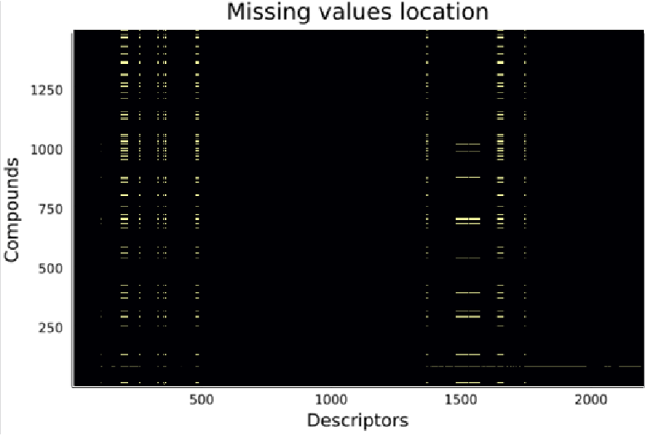
Descriptors acquisition - Selection of descriptors
3-fold descriptor calculation for the Amide dataset
PaDEL is a tool to calculate:
1D descriptors
2D descriptors
3D descriptors
PubChem fingerprints
High variation between the different calculations
2756 descriptors
559 descriptors
99 descriptors
Same descriptor selection for the Greek dataset
2098 descriptors
Normalization
For descriptors with values >1000

Slide 4
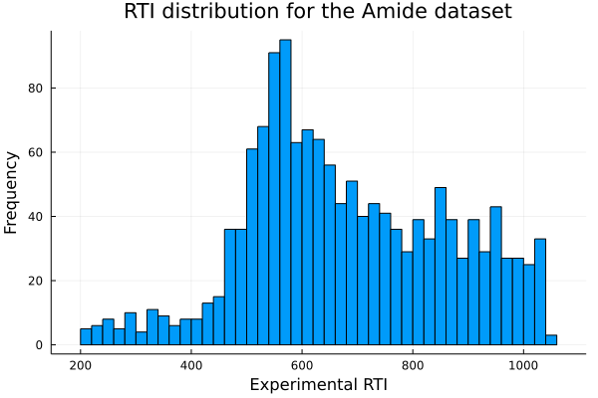
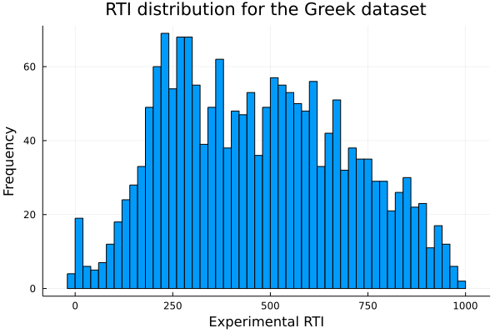
Summary of the datasets

Slide 5
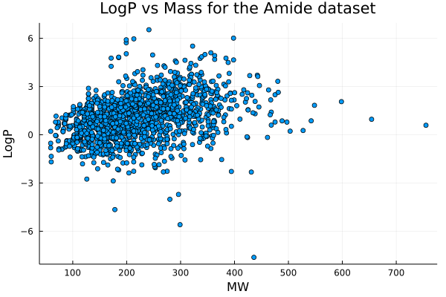
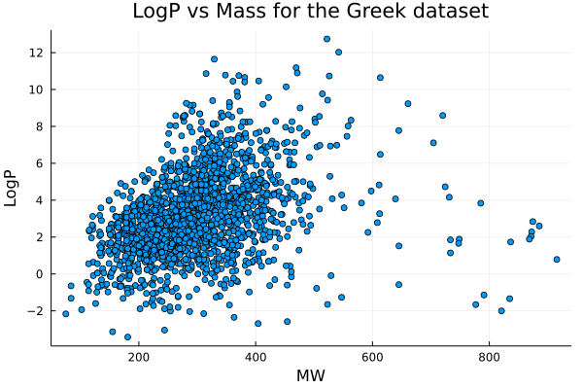
Summary of the datasets

Slide 6
Regression model
Random forest regression
Used to provide an error estimate of the model
Out-of-bag approach
Maximum features
Number of trees
Minimum samples per leaf

Slide 7


Regression model
Random forest regression
Out-of-bag approach
Maximum features
$$\sqrt{number of descriptors}$$
Classifier
Regression
$$\frac{number of descriptors}{3}$$
Number of trees
Minimum samples per leaf

Slide 8
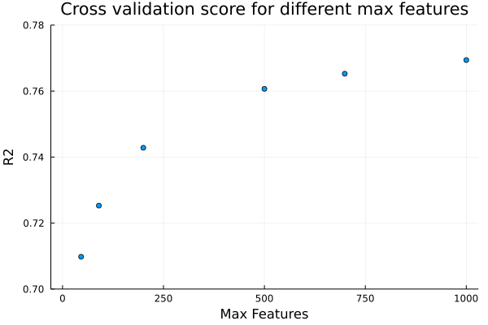


Regression model
Random forest regression
Maximum features
$$\sqrt{number of descriptors}$$
Classifier
Regression
$$\frac{number of descriptors}{3}$$

Slide 9
Regression model
Random forest regression
Out-of-bag approach
Maximum features
Number of trees
Minimum samples per leaf
Optimization!

Slide 10
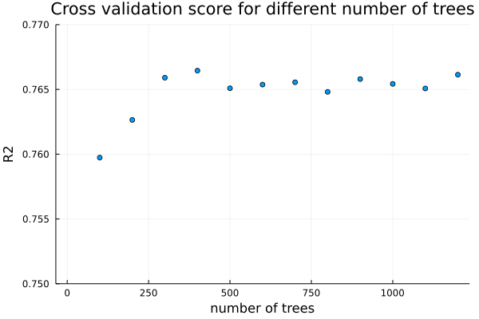
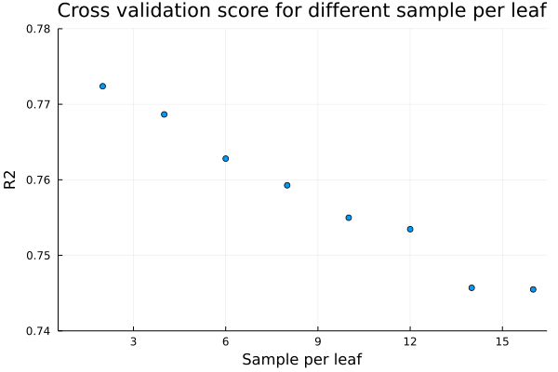
Regression model – Optimization
Number of trees
Minimum samples per leaf
We have the optimized parameters. Let’s build the model!
No significant difference above 300 trees
Lower values improve the accuracy of the model

Slide 11
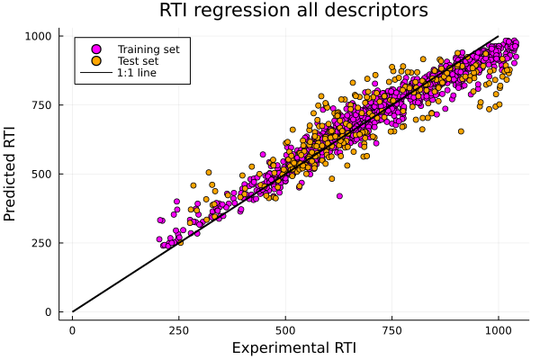
Regression model – Amide dataset
Most important descriptors
1 | Mannhold LogP
2 | Crippen's LogP
3 | Number of carbon atoms
4 | XLogP
5 | Bond information content index (neighborhood symmetry of 0-order)
6 | Molar refractivity
7 | Smallest absolute eigenvalue of Burden modified matrix-n 2/ weighted by relative I-state
R² (training set) = 0.95
R² (test set) = 0.77
Cross validation 5-fold average = 0.77

Slide 12
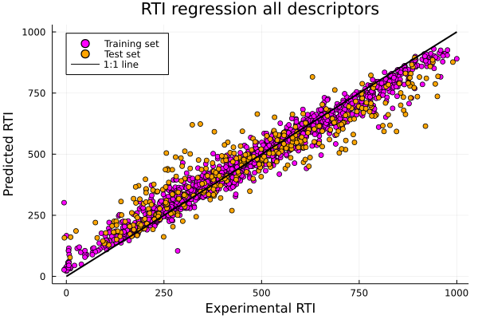
Regression model – Greek dataset (Not fully optimized)
Most important descriptors
1 | Estrada-like index from topological distance matrix
2 | Z-modified information content index (neighborhood symmetry of 2-order)
3 | Number of double bonds
4 | Average molecular weight (Molecular weight / Total number of atoms)
5 | Z-modified information content index (neighborhood symmetry of 5-order)
6 | Z-modified information content index (neighborhood symmetry of 4-order)
7 | Complexity of a molecule
R² (training set) = 0.97
R² (test set) = 0.85
Cross validation 5-fold average = 0.84

Slide 13
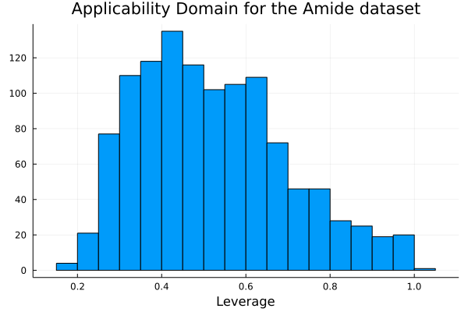
Applicability domain
The leverage of every compound to the training set was calculated
To be done…

Slide 14
NEW SLIDES FROM NOW ON!

Slide 15
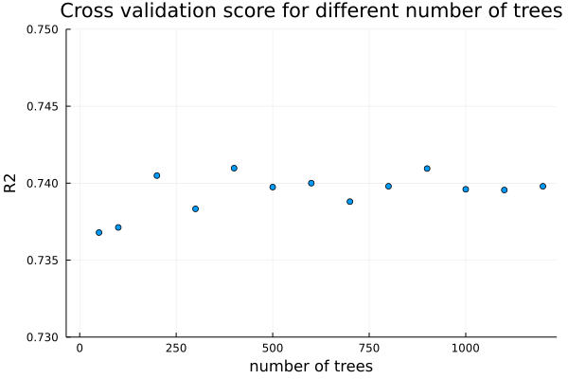
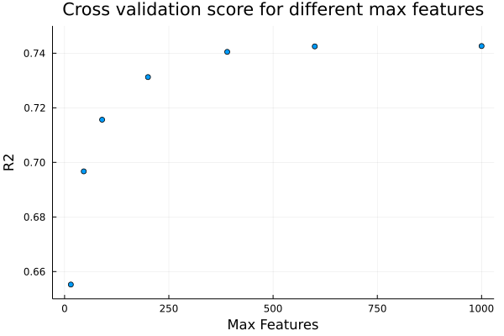
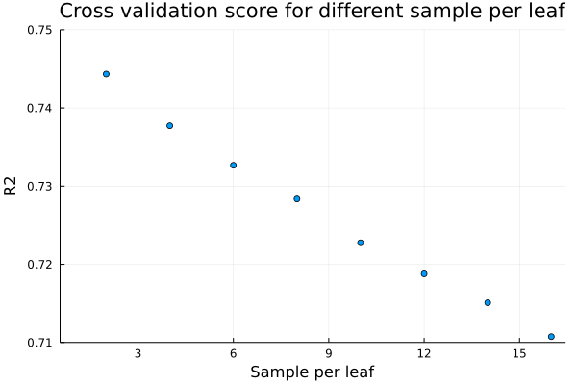
Optimization – Amide dataset
Notes:
Sample/leaf = 4
N_est = 400
Max_feat = 390

Slide 16
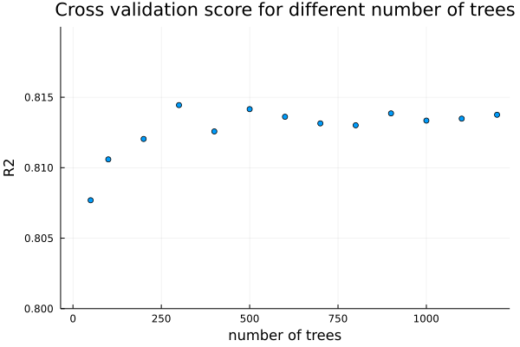
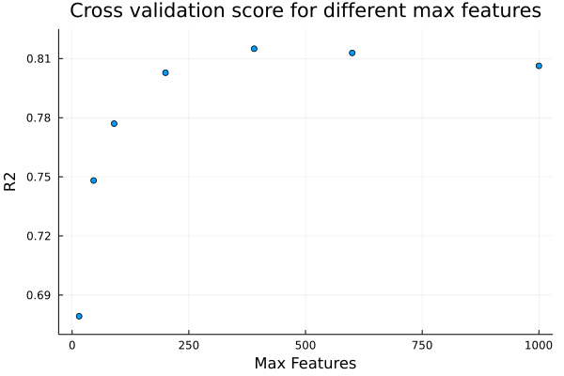
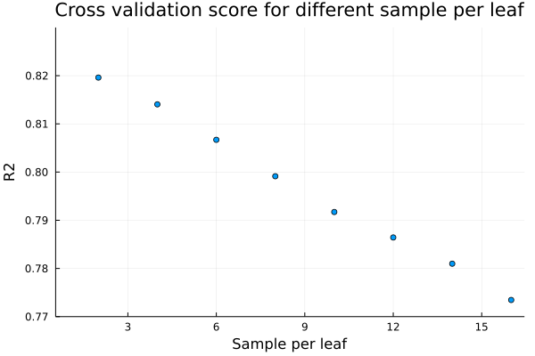
Optimization – Greek dataset
Notes:
Sample/leaf = 4
N_est = 500
Max_feat = 390

Slide 17
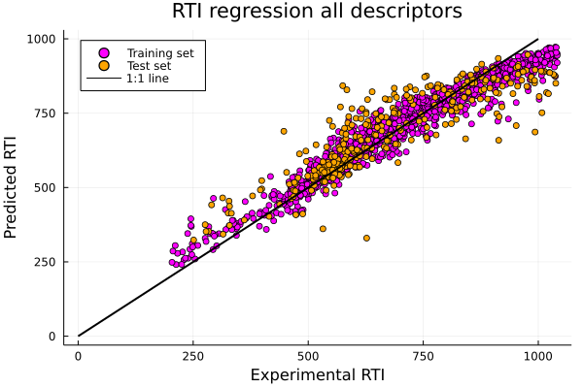
Regression model – Amide dataset
Most important descriptors
1 | MLogP
2 | CrippenLogP
3 | nC
4 | CrippenMR
5 | piPC3
6 | C2SP2
7 | piPC10
R² (training set) = 0.94
R² (test set) = 0.75
Cross validation 5-fold average = 0.74

Slide 18
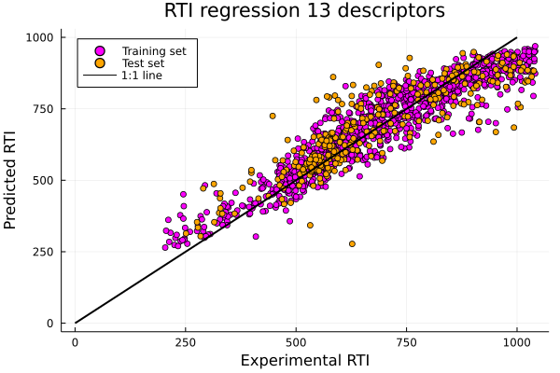
Partial Regression model – Amide dataset
Used descriptors
1 | MLogP
2 | CrippenLogP
3 | nC
4 | CrippenMR
5 | piPC3
6 | C2SP2
7 | piPC10
8 | MPC10
9 | piPC2
10 | PubchemFP11
11 | WTPT-5
12 | nBase
13 | MATS1e
R² (training set) = 0.88
R² (test set) = 0.73
Cross validation 5-fold average = 0.70

Slide 19
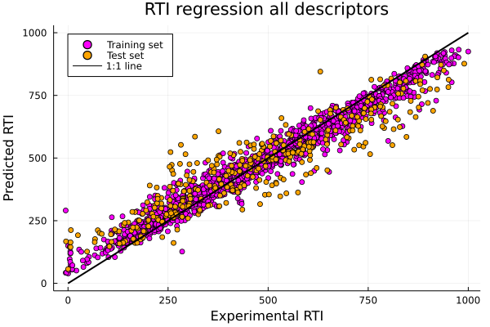
Regression model – Greek dataset
Most important descriptors
1 | CrippenLogP
2 | nBase
3 | McGowan_Volume
4 | CrippenMR
5 | nHBDon_Lipinski
6 | MLFER_L
7 | MLogP
R² (training set) = 0.96
R² (test set) = 0.83
Cross validation 5-fold average = 0.81

Slide 20
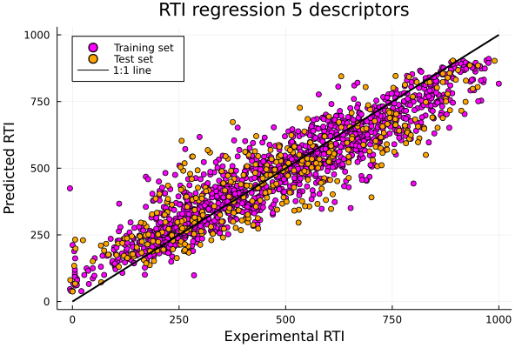
Partial Regression model – Greek dataset
Used descriptors
1 | CrippenLogP
2 | nBase
3 | McGowan_Volume
4 | CrippenMR
5 | MLFER_L
R² (training set) = 0.87
R² (test set) = 0.77
Cross validation 5-fold average = 0.74

Slide 21
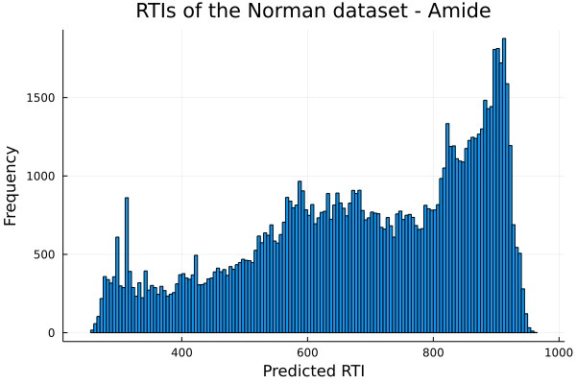
Amide prediction of Norman RTIs

Slide 22
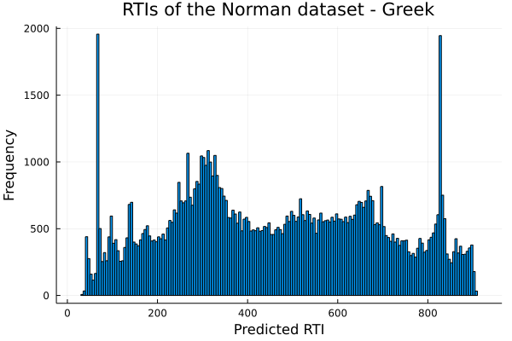
Greek prediction of Norman RTIs

Slide 23
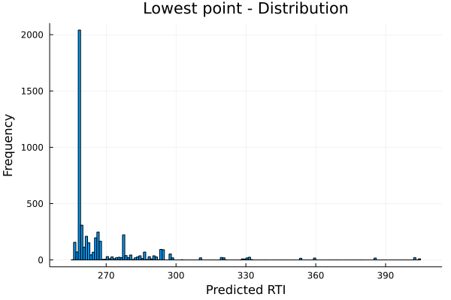
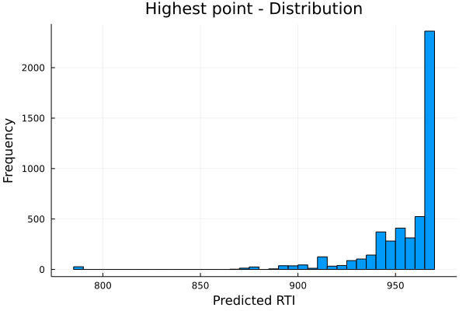
Amide LoHi distributions
Lowest point 255.6
Highest point 968.9
Notes:
968,9-255,6=713,3
5% -> 291,27
95% -> 933,24

Slide 24
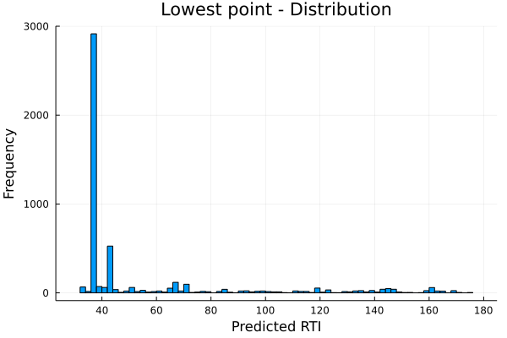
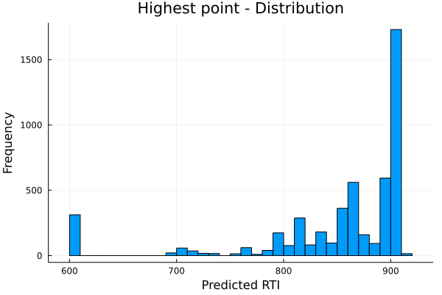
Greek LoHi distributions
Lowest point 32.5
Highest point 910.2
Notes:
910,2-32,5=877,7
5% -> 76,39
95% -> 866,32

Slide 25
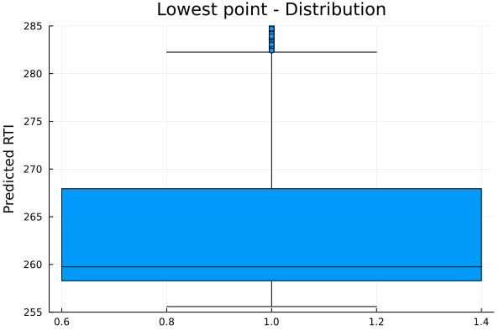
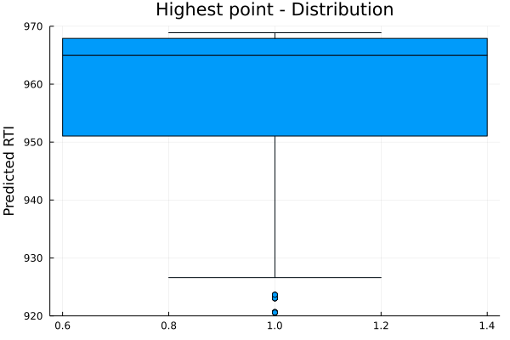
Amide LoHi Boxplots
Lowest point 255.6
Highest point 968.9

Slide 26
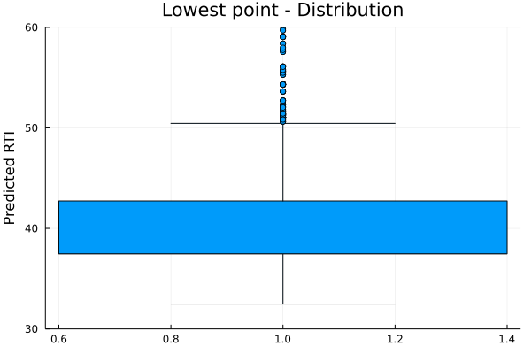
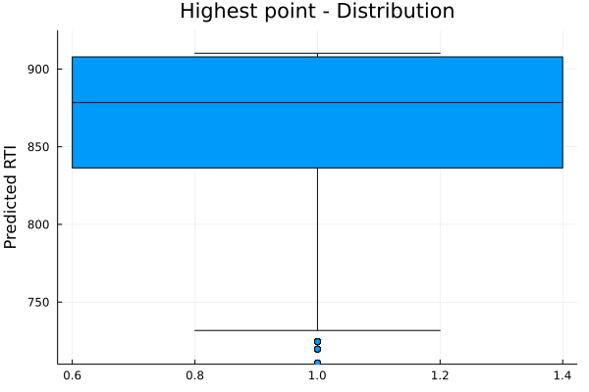
Greek LoHi Boxplots
Lowest point 32.5
Highest point 910.2

Slide 27
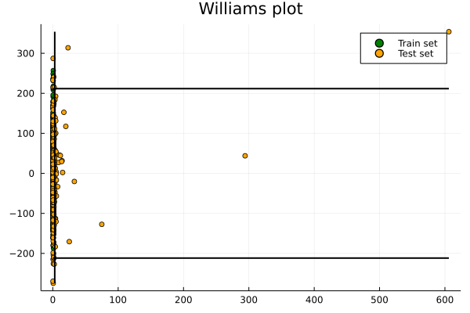
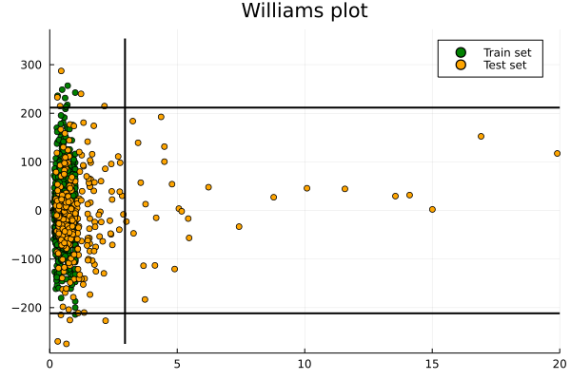
Amide Williams plots

Slide 28
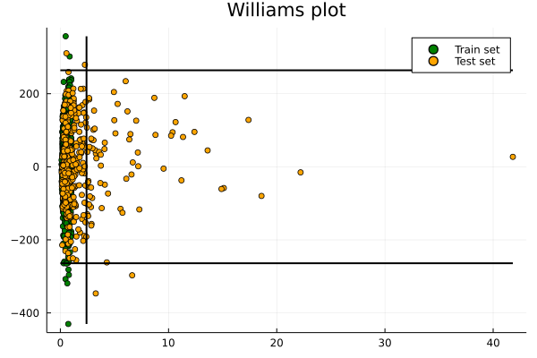
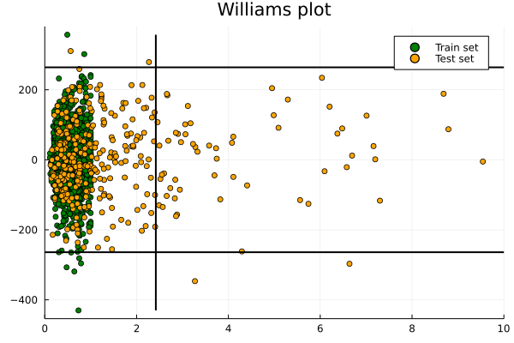
Greek Williams plots

Slide 29
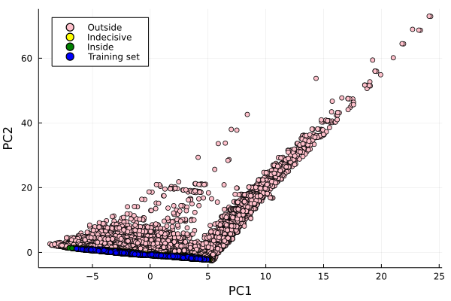
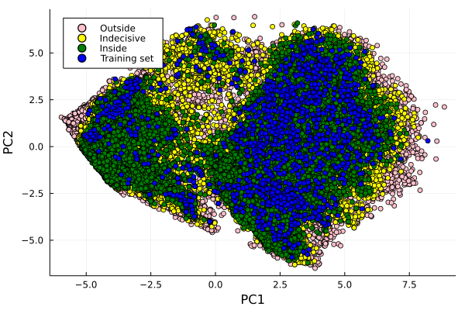
PCA
Amide
Greek

